Slide 1
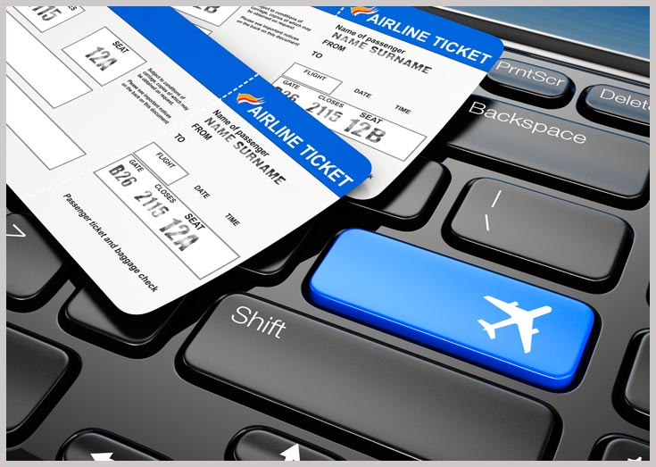
FLIGHT BOOKING
SYSYTEM

Slide 2
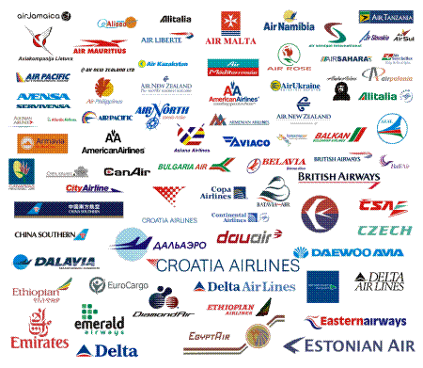
CONTENTS :
Abstract
About Front end & Back end
Screen Outputs

Slide 3
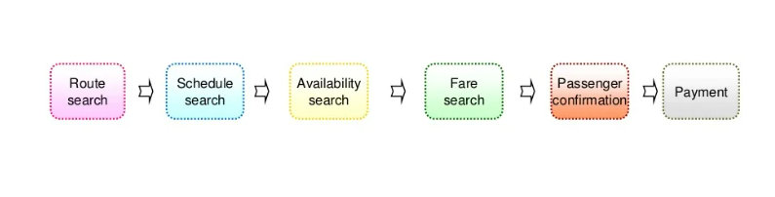
ABSTRACT
An flight booking system is an application supporting the direct contact with the passenger. This system make the life of passengers very easy as they don’t need to stand in queues for getting their seats reserved and they can easily make reservations on any airline just from a single system.

Slide 4
About Front end & Back end
Front end:
html
CSS
Bootstrap
Back end:
Django framework
SQLite

Slide 5
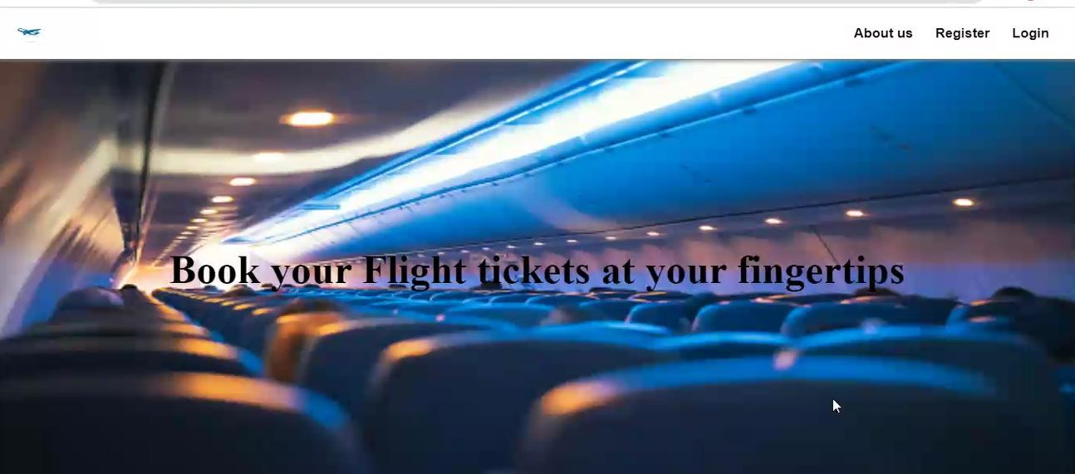
SCREEN OUTPUTS:

Slide 6
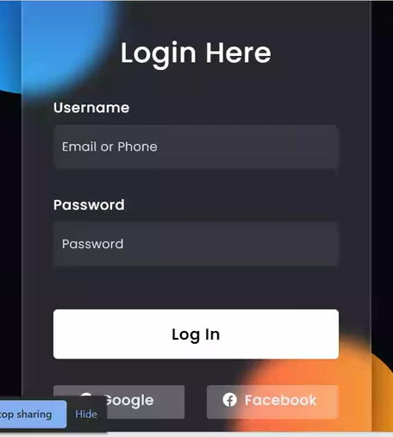
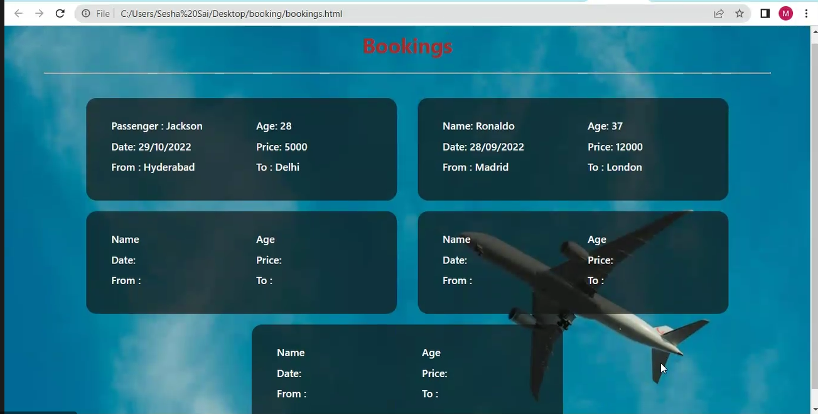

Slide 7
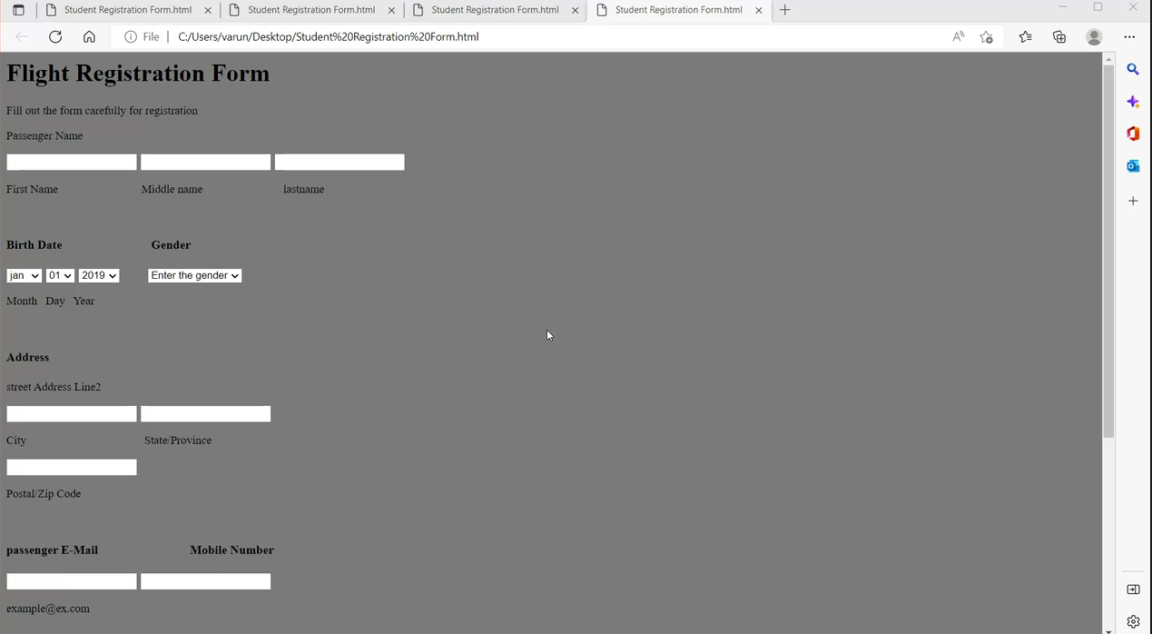

Slide 8
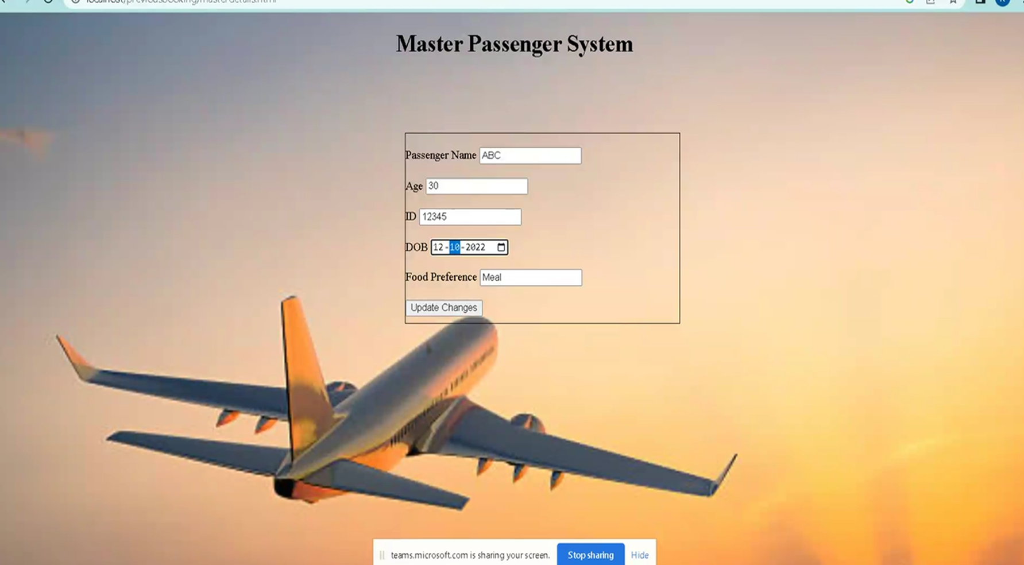
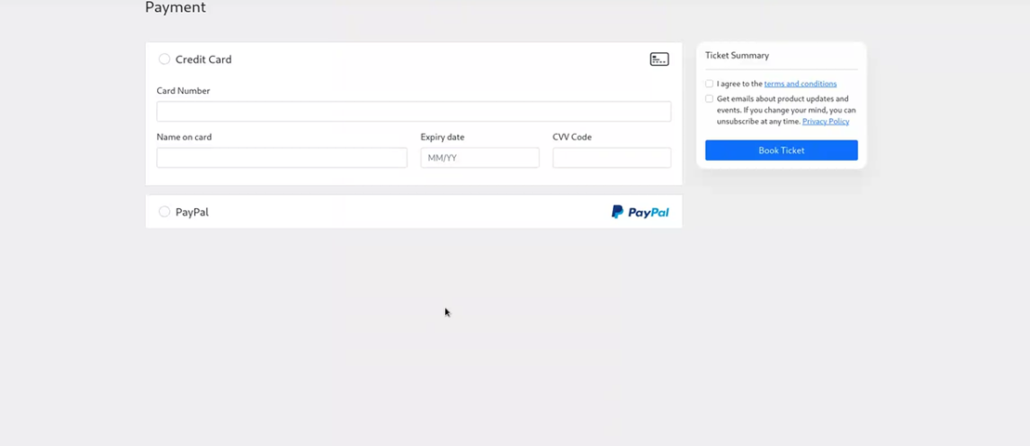

Slide 9


